Slide 1
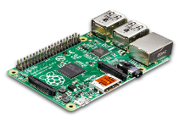
Normal System behavior
Learning Phase
IoT Device
Graph Similarity
Detection Phase
Anomaly

Slide 2
Normal System behavior
Learned Provenance
IoT Device
Graph Similarity
Observed Provenance
Anomaly

Slide 3
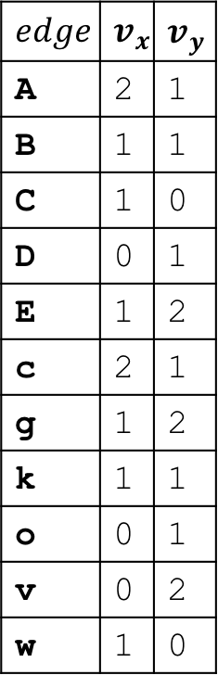
$$edge$$ | $$v_{x}$$ | $$v_{y}$$
A | 2 | 1
B | 1 | 1
C | 1 | 0
D | 0 | 1
E | 1 | 2
c | 2 | 1
g | 1 | 2
k | 1 | 1
o | 0 | 1
v | 0 | 2
w | 1 | 0
A
c
B
A
o
D
g
v
k
E
c
c
E
v
x
g
C
A
B
E
w
g
(a) Learning Phase
(b) Detection Phase

Slide 4



$$e_{5}$$
$$wGB$$
$$e_{6}$$
Agent
Activity
Entity

